Slide 1
Real Estate Management System

Slide 2
Team members
Name | Role
Battuvshin Badarch | Team Leader
Aldarkhangai Chimed Ochir | Back-end Developer
Ferdinand Muriyesu | Back-end Developer
Dulamkhand Batjargal | Front-end Developer

Slide 3
Overview
The Real Estate Management system is a web based application which connect property sellers and buyers or renters. In this system there are four actors or users: Admin, Buyer, Seller and Manager or Agent.

Slide 4
Key features
Admin:
Approve pending requests of new property
View, create, update, delete property
Give information

Slide 5
Key features
Seller:
Register/login/logout
View, create, update, delete property
Give information
Sell, rent, buy delegate service

Slide 6
Key features(Con’t)
Buyer
Search
Register, login. Logout
Ask information
Book appointment
Propose offer
Buy, rent

Slide 7
Key features(Con’t)
Manager
Give information
Introduce property

Slide 8

Model 2 Architectures
Web browser
(Client Request)
Request
DB/MySQL
DAO
JDBC
Servlet Controller
HTTP
JSP
Model
Response
Web Container (Tomcat)
Web server, Apache Tomcat

Slide 9
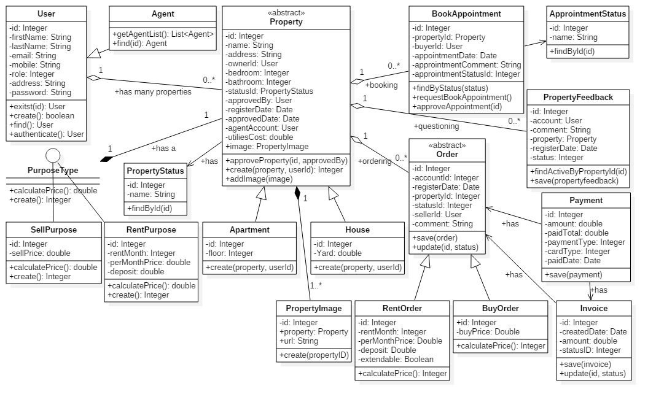
Business model & Associations

Slide 10
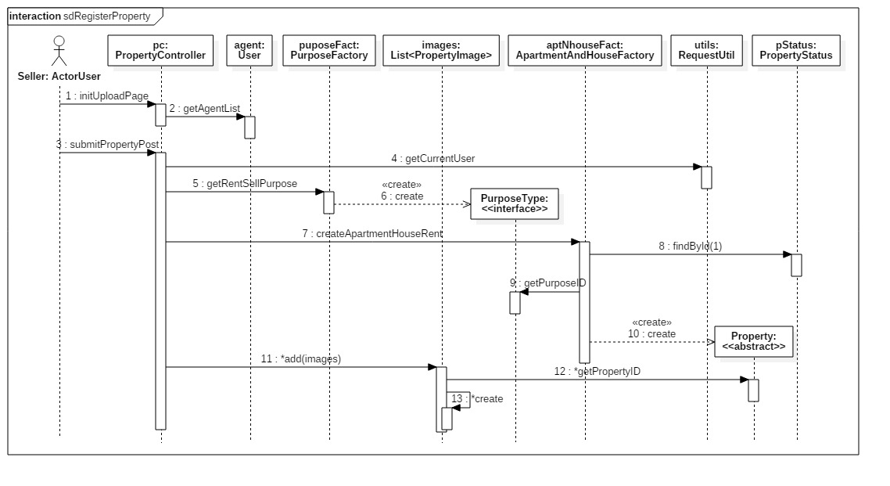
Example of sequence diagram/ Property registration

Slide 11
Tools used
IDE: Eclipse for backend and some frontend work,
Visual studio code for frontend
starUML for diagrams
Maven in Eclipse to ease the build process
Navicate and PHP my admin for database management
TortoiseGit for subversion version control
Apache tomcat 8.5 for application server.

Slide 12
Technology
The project is developed following MVC architecture approach,
Therefore the presentation is separated from the backend .
Java is the programming language used for backend development. Servlets were used as controllers, and the model is made of java classes.
Java 1.8
Servlet 3.1.0
JSTL 1.2
JSP, HTML5, JavaScript, jQuery 3.2.1 and Bootstrap v3.0.3 were used on front end.
gitHub was used to share the work between members and truck the progress.
MySQL 5.6.36 was used as database.
Apache maven 3.3.9 was used project management

Slide 13
Thank you
Show the demo

